Slide 1
Relocating & Redesigning Needle Coating Facility Six Sigma Quality Project Metal Cladding Inc

Slide 2
Project Statement:
The current layout of the needle coating unit at Metal Cladding Inc consists of three separate rooms coating, inspection and packaging
The process is inefficient because of a lot of non-value-added motion which delays the production
They needed a new layout to optimize their timings and production

Slide 3
Overview
Problem Statement
Redesign and relocate facility.
Current Performance
30,000 products per day
Target Performance
Double the production i.e. 60000 products per day.
Analysis
Selection of area for new facility from available space.
Determined flow of product during manufacturing.
Determined motion of the workers.
Recommendations
In-Line work design for new facility.
Install two more coating machines.
Install one more oven for drying.
Hire 2 more workers.

Slide 4
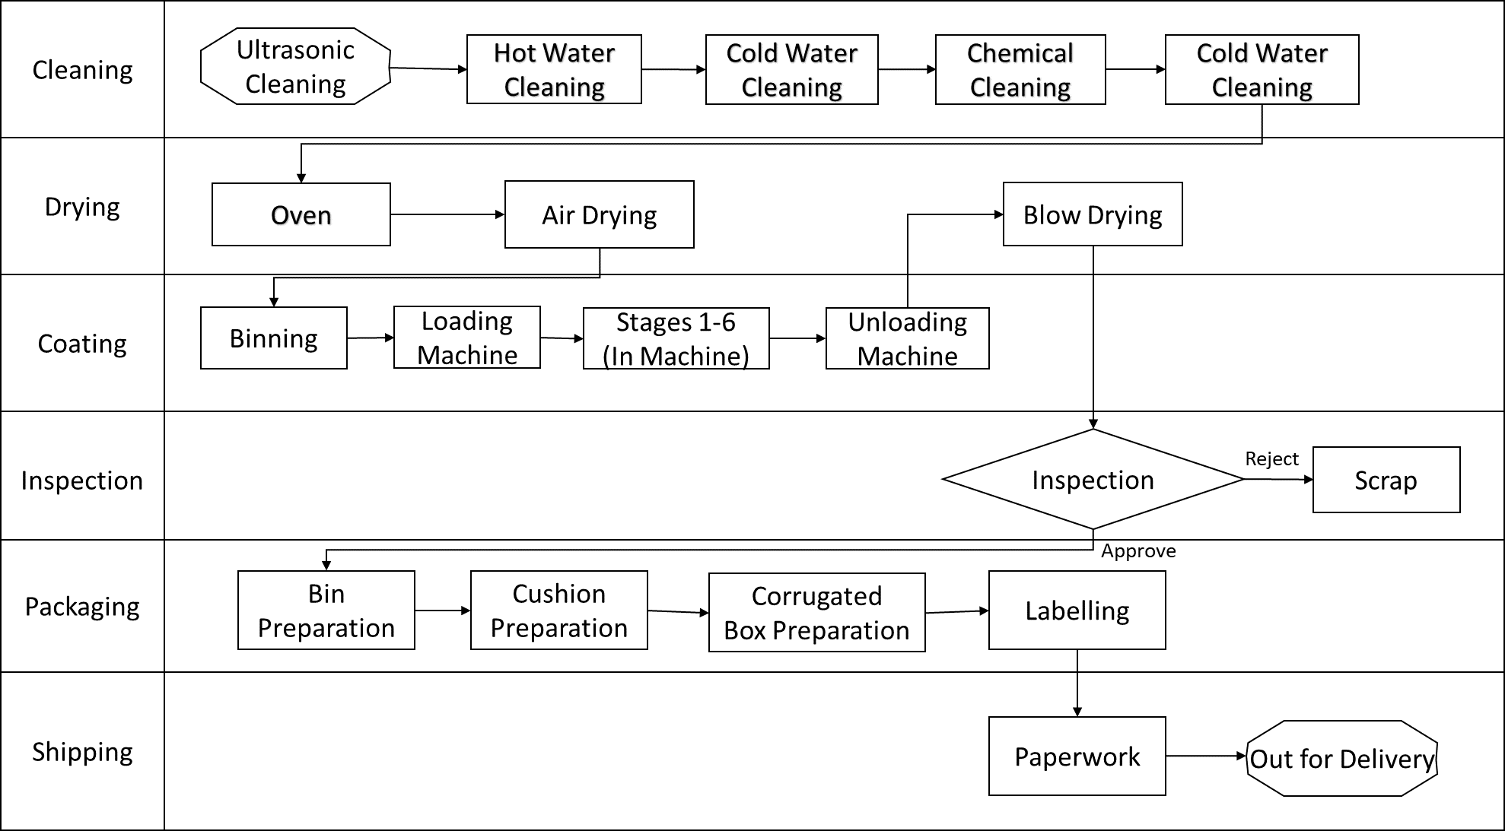
Process Flow Diagram
Define Measure Analyze Improve Control

Slide 5
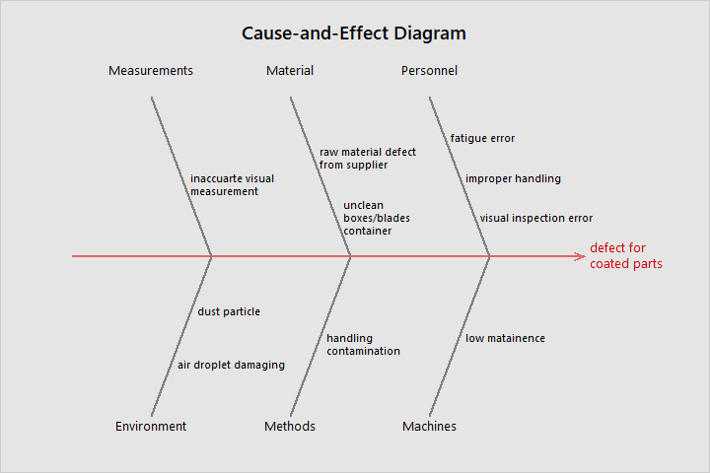
Cause & Effect Diagram (Defects)
Define Measure Analyze Improve Control

Slide 6
SIPOC Diagram
Suppliers
Inputs
Process
Outputs
Customers
Requirements
Hobson Motzer
Classified
Needles
Coating Liquid
Inspection
Corrugated Box
Bubblewrap
Sticking Tape
Insert temp
Clean Room
See Below
Needles
Consolidated Medical Equipment
Dalian Maxtrust Industry Co. Ltd.
Customer requires defects less than 3%
Define Measure Analyze Improve Control
Step 1:
Cleaning
Step 2:
Coating
Step 3:
Drying
Step 4:
Packaging
Step 5:
Shipping

Slide 7
Current Vs. Target Performances
 | Current Performance | Target Performance
Production | 25000/day | 60,000/day
Flow Lines | Cross-flow | Straighter
Defects | 3% | Less than 2%
Operator Movement | 1613 Ft | Less than 1000 Ft
Define Measure Analyze Improve Control

Slide 8
Data Analysis
Define Measure Analyze Improve Control

Slide 9
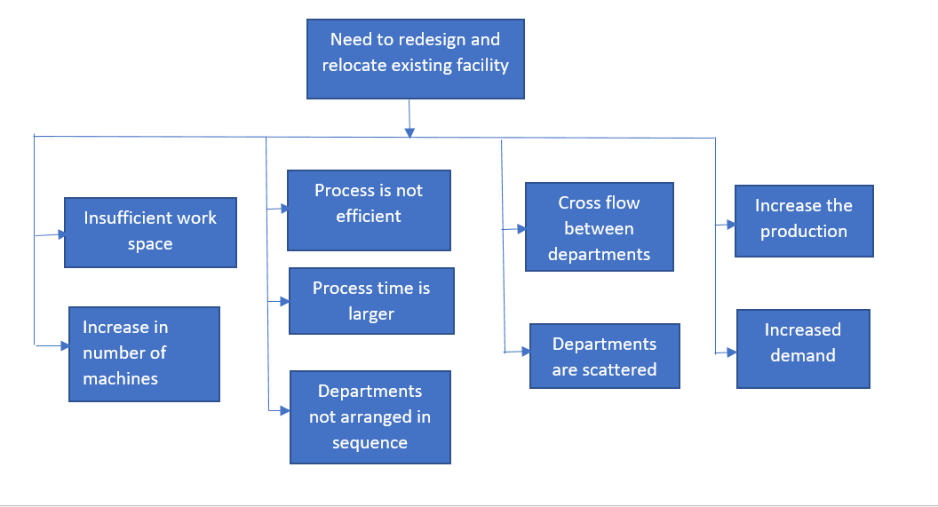
Why-Why Diagram:
Define Measure Analyze Improve Control

Slide 10
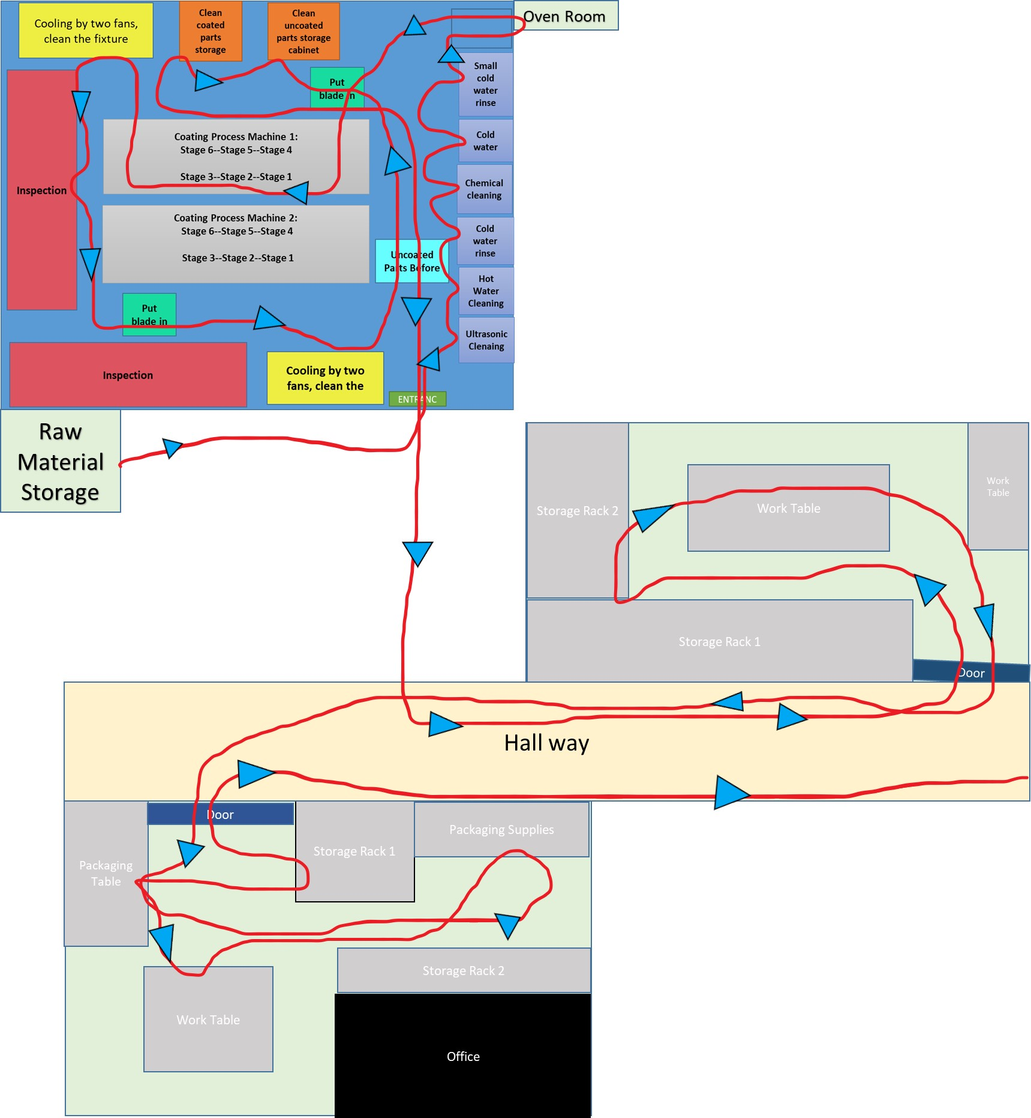
Spaghetti Diagram
Define Measure Analyze Improve Control

Slide 11
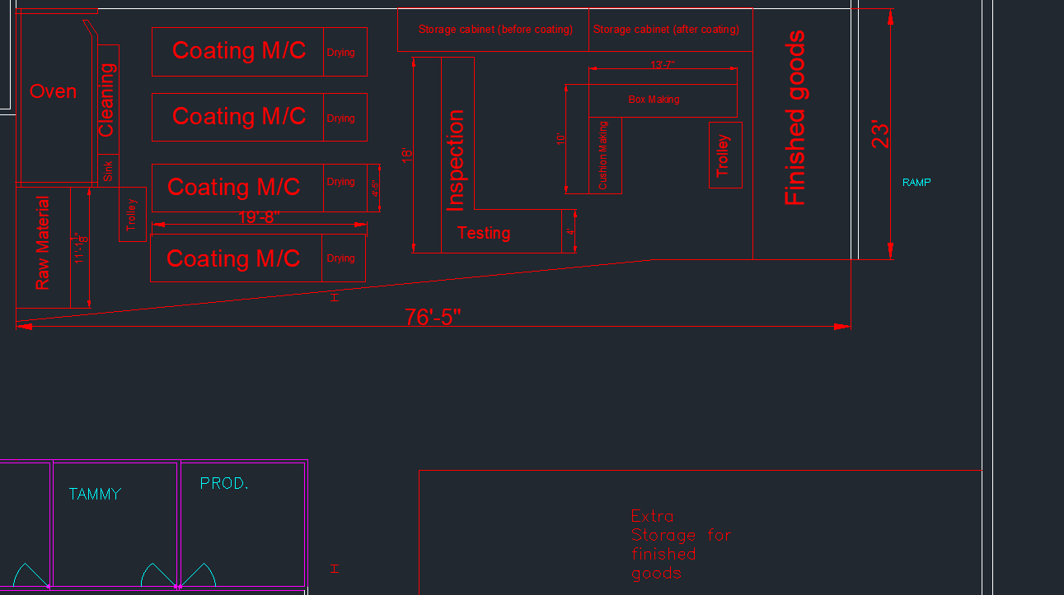
Redesigned Layout
Define Measure Analyze Improve Control

Slide 12
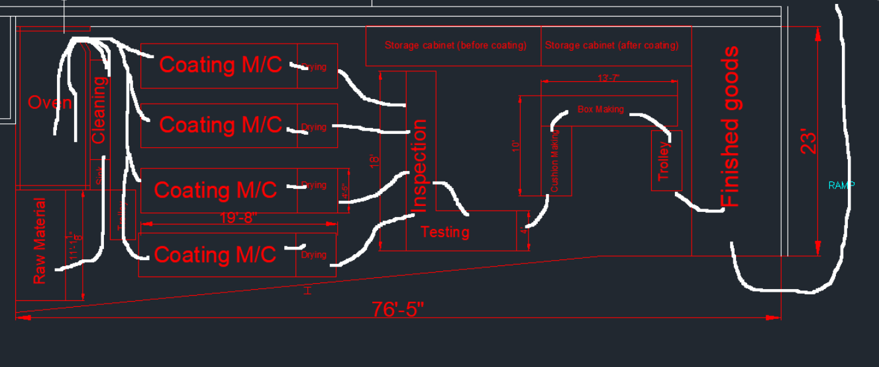
Spaghetti Diagram
Define Measure Analyze Improve Control

Slide 13
Improvements
Solutions
A redesigned layout.
Hire 4 more employees.
Add another oven.
Add 2 more coating machines.
Define Measure Analyze Improve Control

Slide 14
Alternative Solutions: Arena Simulation
 | Current | Case 1 | Case 2 | Case 3
No. of Machines | 2 | Double | Double | Double
No. of Ovens | 1 | 1 | Double | Double
No. of Operators | 7 | Same as current | 4 more | Same as current
No of Produces Parts | 33,859 | 37,900 | 63,075 | 57,510
Bottleneck |  | From machine to oven | All Goals Achieved | Output is less
Define Measure Analyze Improve Control
Case 1
Case 2
Case 3

Slide 15

Verification of Findings
Selling price of each blade is $0.88
The return on investment per year is 53%
The company will get back all the investment within 7 months.
Define Measure Analyze Improve Control

Slide 16
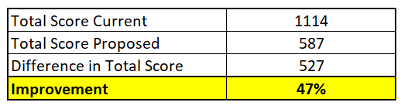
Control
Poka-Yoke
While redesigning, Poka-Yoke was inadvertently used in blow-drying coated needles
Comparison of results of distance flow matrices for current and proposed layout
Distance flow Matrix
Define Measure Analyze Improve Control

Slide 17
Recommendation(s)
Space available for additional machine or more Storage
Can be utilized to further increase production in the future.
Use 5S tool for sustaining stability

Slide 18
Summary
Problem
Redesign and relocate facility to double production.
Solution(s)
Optimized Layout
Add 2 more coating machines,
Add 1 more Oven
Add 4 more operators
Potential Benefit
Doubled production
Simple and efficient layout

Slide 19
Thank You! Any Questions?

